Slide 1
Edge Connectivity
The number of edges in the smallest cut set (i.e., cut set with fewest number of edges) is defined as the edge connectivity of G.
Edge connectivity of a connected graph can be defined as the minimum number of edges whose removal (i.e., deletion ) reduces the rank of the graph by one.
The edge connectivity of a tree is one.

Slide 2
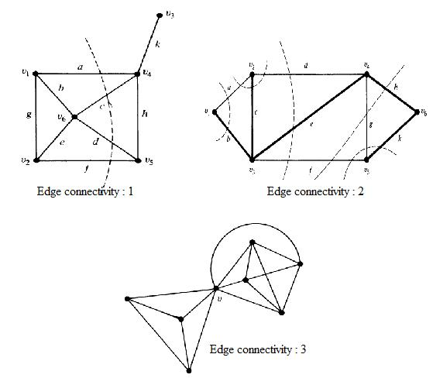

Slide 3
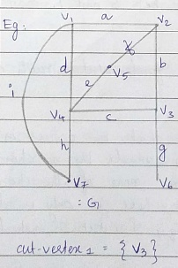
Cut-Vertices
In a connected graph G, a cut-vertices a set of vertices whose removal from G leaves G disconnected.

Slide 4
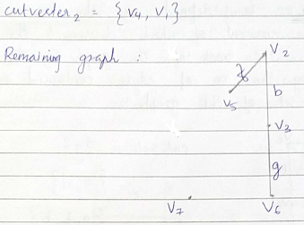

Slide 5
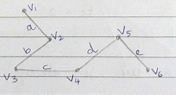
Since removal of any vertex from a tree breaks the tree into two parts, every vertex of a tree is a cut-vertex except pendant vertices.

Slide 6
Vertex Connectivity
Vertex connectivity of a connected graph G is defined as the minimum number of vertices whose removal from G leaves the remaining graph disconnected.
Vertex connectivity of a tree is one.

Slide 7
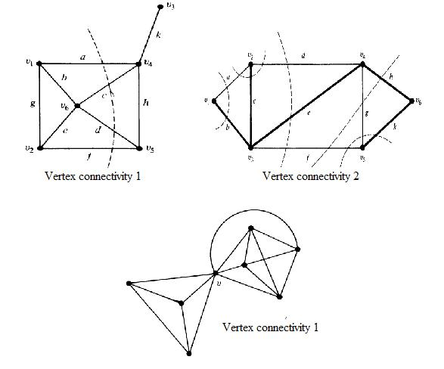

Slide 8
Separable Graph
A connected graph is said to be separable if its vertex connectivity is one.
All other connected graphs are called non-separable.
In a separable graph, a vertex whose removal disconnects the graph is called a cut-vertex, a cut node or an articulation point.

Slide 9
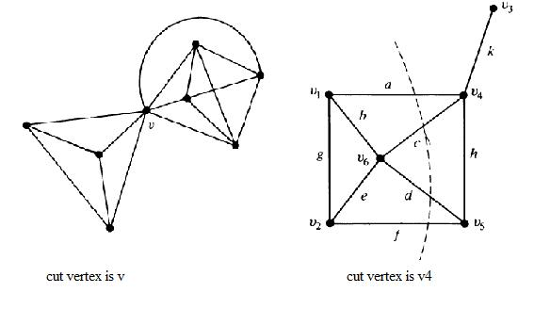

Slide 10
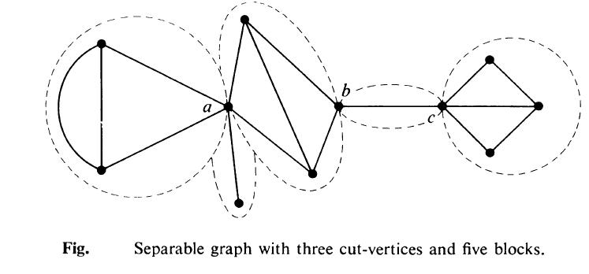
A separable graph consists of two or more non-separable subgraphs.
Each of the largest non-separable subgraphs is called a block.

Slide 11
Theorem
A vertex v in a connected graph G is a cut-vertex if and only if there exist two vertices x and y in G such that every path between x and y passes through v.

Slide 12
An Application
Given n stations, that are to be connected by means of e lines (telephone lines, bridges, rails, tunnels or highways).
What is the best way of connecting ???
Construct a graph with n vertices and e edges that has the maximum possible edge connectivity and vertex connectivity.

Slide 13
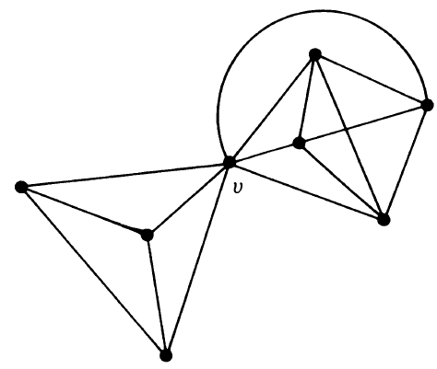
For eg: graph with n=8 and e=16
EC = 3
VC = 1

Slide 14
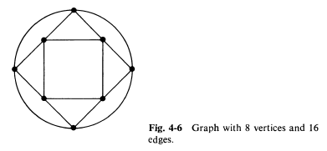
EC = VC = 4

Slide 15
Theorem:
The edge connectivity of a graph G cannot exceed the degree of the vertex with the smallest degree in G.
Theorem:
The vertex connectivity of any graph G can never exceed the edge connectivity of G.

Slide 16
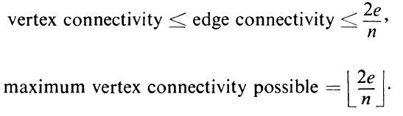
The maximum vertex connectivity one can achieve with a graph G of n vertices and e edges is the integral part of the number 2e/n. ie:

Slide 17
Combinatorial and Geometric Representation of Graphs

Slide 18
Combinatorial Graphs
An abstract graph G can be defined as
G=(V,E,Ψ ),
where the set V= {a,b,c,d,e} ,a set of 5 objects and
E={1,2,3,4,5,6,7},a set of 7 objects
and the relationship is defined by the mapping Ψ, which consists of

Slide 19
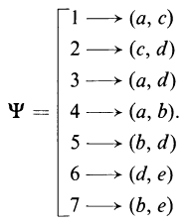

Slide 20
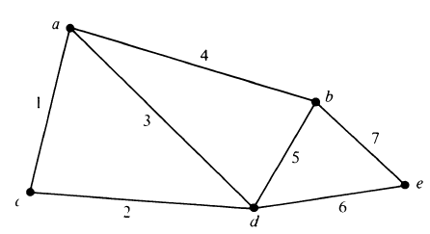
Geometric Graphs
One of the many geometric way of representing the abstract/combinatorial graph G.

Slide 21
Planar Graph
A graph G is said to be planar if there exists some geometric representation of G which can be drawn on a plane such that no two of its edges intersect.
A graph that cannot be drawn on a plane without a crossover between edges is called non planar.

Slide 22
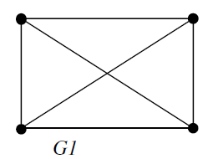
Geometrical Representation
Plane Representation

Slide 23
The geometric representation of planar graph on any surface is called embedding.
An embedding of a planar graph G on a plane is called a plane representation of G or a plane graph.
Plane Graph/Embedded Graph - A graph that is drawn on the plane without edge crossing.

Slide 24
(a) planar, not a plane graph
(c) another plane graph
(b) a plane graph

Slide 25
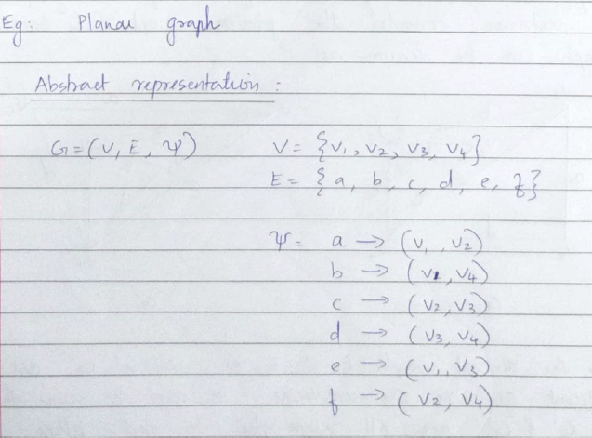

Slide 26
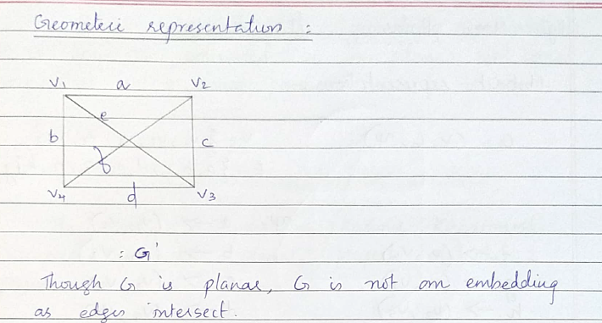

Slide 27
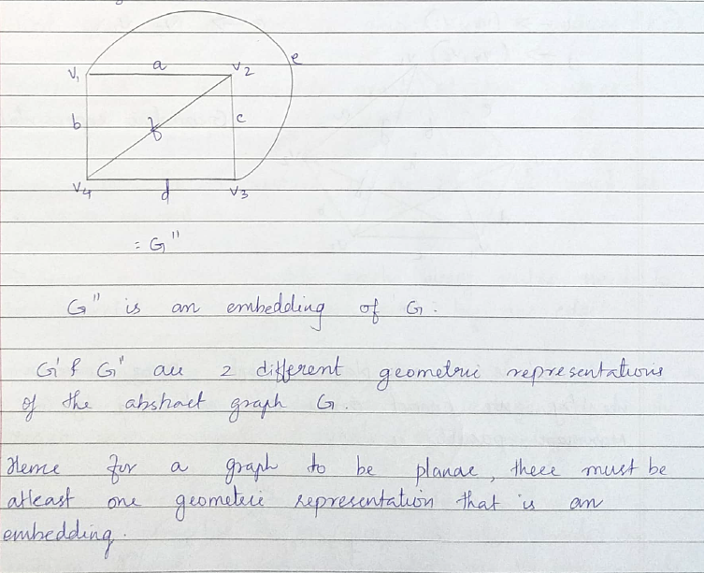

Slide 28
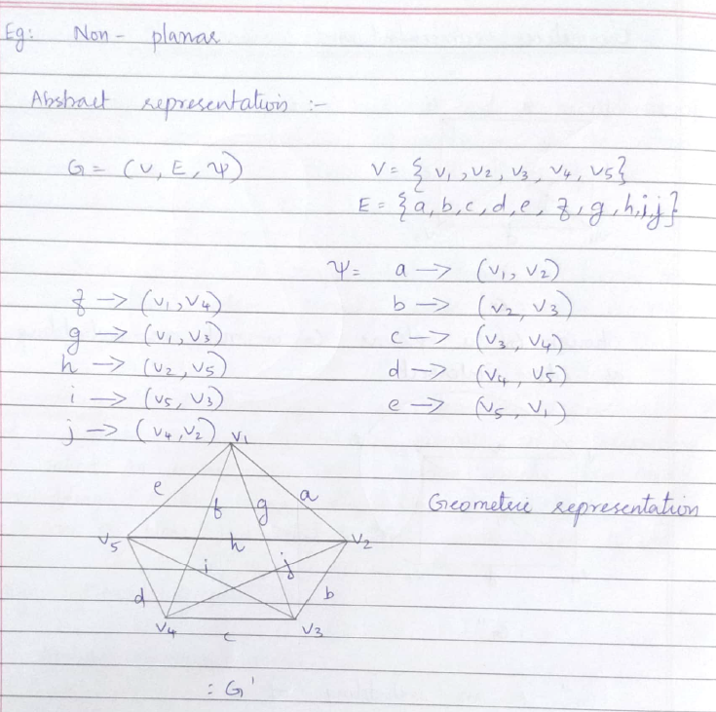

Slide 29
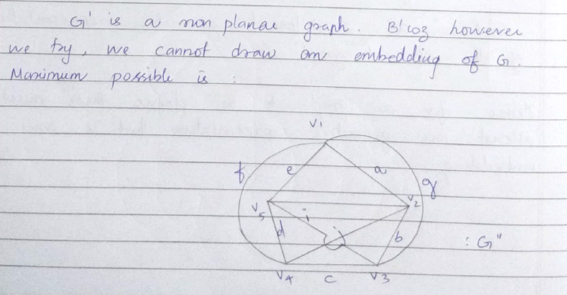
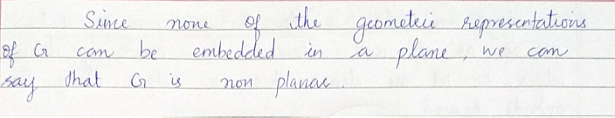

Slide 30
How can you tell if a graph G is Planar or Nonplanar ?

Slide 31
Kuratowski’s Two Graphs
After the Polish Mathematician Kasimir Kuratowski,
A complete graph with five vertices is nonplanar.
Regular connected graph with six vertices and nine edges is also nonplanar.

Slide 32
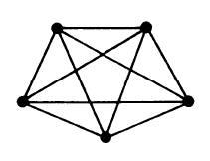
Kuratowski’s 1st Graph: Theorem
A complete graph with five vertices is Nonplanar, K5.

Slide 33
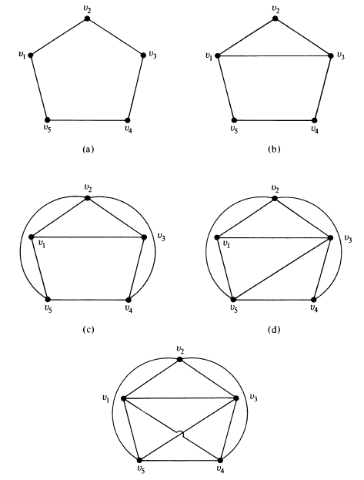

Slide 34
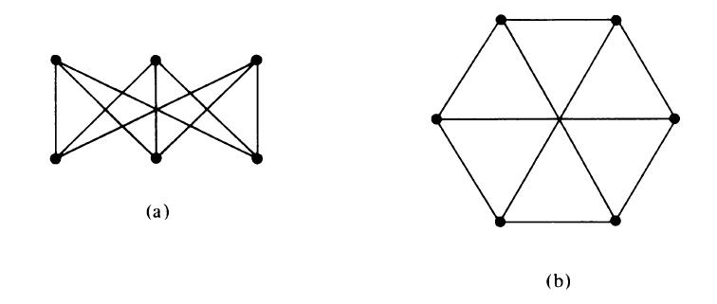
Kuratowski’s 2nd Graph : Theorem
Regular connected graph with six vertices and nine edges is also non-planar, K3,3.

Slide 35
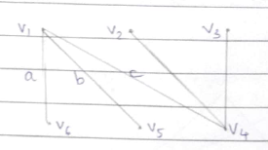
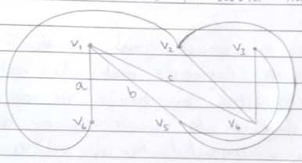
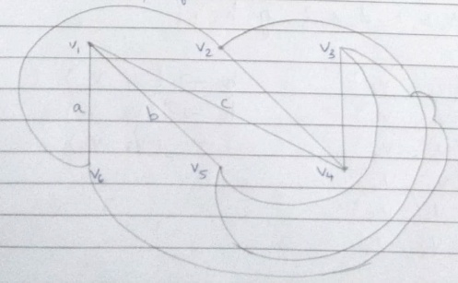

Slide 36
Properties of Kuratowski’s Graphs
Both are regular graphs.
Both are non planar.
Removal of one edge or a vertex makes each a planar graph.
Kuratowski’s first graph – non-planar graph with the smallest number of vertices and Kuratowski’s second graph – non-planar graph with the smallest number of edges.
Simplest non-planar graphs

Slide 37
Different Representation of Planar Graphs
Straight Line Representation
Plane Representation
Embedding on a Sphere

Slide 38
Straight Line Representation
Any simple planar graph can be embedded in a plane such that every edge is drawn as a straight line segment.
This representation is only used for simple graph because self loop and parallel edges cannot be represented by straight line.

Slide 39
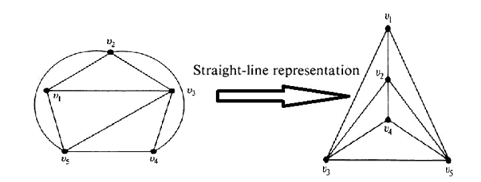

Slide 40
Plane Representation
A plane representation of a graph divides the plane into regions.
A region is bounded by the set of edges of the graph.
No region – for nonplanar graphs and planar graphs which are not an embedding.
also called windows, faces, or meshes.

Slide 41
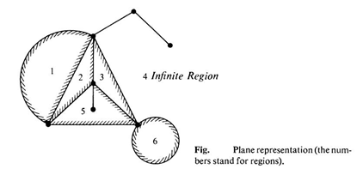
Infinite Region: The portion of the plane lying outside a graph embedded in a plane - infinite, unbounded, outer, or exterior region.

Slide 42
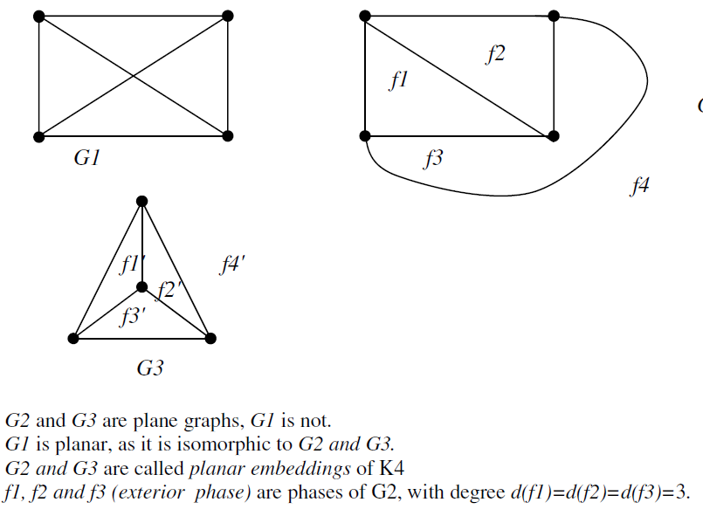

Slide 43
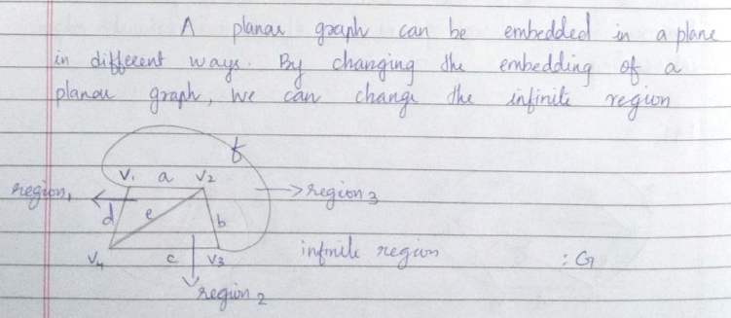
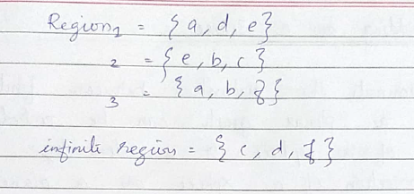

Slide 44
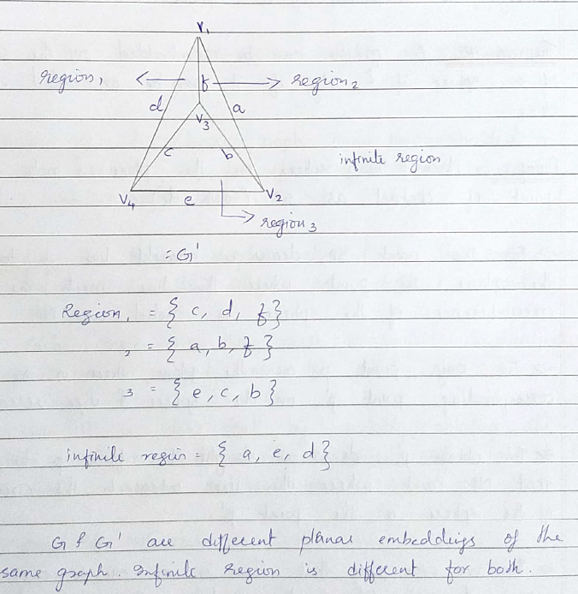

Slide 45
Euler’s Theorem
Euler’s formula gives the number of regions in any planar graph
Theorem:
A connected planar graph with n vertices and e edges has e-n+2 regions
f= e-n+2

Slide 46
Proof :
We prove the theorem by induction on e.
Basis of Induction :
If e=0, then G must have just one vertex – isolated vertex
i.e.: when e=0, n=1
f = e-n+2
= 0-1+2 = 1 (infinite region)

Slide 47
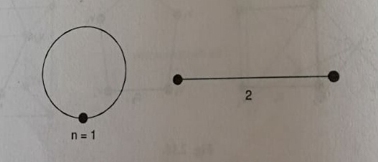
If e= 1, n=1 or 2
If n=1, self loop
f = e-n+2
= 1-1+2 = 2 regions (inner and outer)
If n= 2,
f = e-n+2
= 1-2+2 = 1 region (infinite)

Slide 48
Induction Hypothesis :
Now we suppose that the result is true for any connected plane graph G with e-1 edges.
Induction step :
We add one new edge K to G. i.e. : G+K.
There are 3 possibilities:
1) K is a self loop
New region is created but the number of vertices remains unchanged.
No. of regions increased by one.

Slide 49
2) K joins 2 distinct vertices of G
One of the region of G is split into 2.
No. of regions increased by one.
No. of vertices remains unchanged.
3) K is incident with only one vertex of G
So, another vertex must be added.
Increasing the number of vertices by one.
No. of regions unchanged.

Slide 50
Let n’, e’ and f ’ denote the number of vertices, edges and regions in G and n , e, and f in G+K
f= e-n+2 can be written as n-e+f = 2
Then ,
K is a self loop :
n-e+f = n’-(e’+1)+(f’+1)
= n’ – e’ + f ’

Slide 51
2) K joins distinct vertices of G
n-e+f = n’-(e’+1)+(f’+1)
= n’ – e’ + f ’
3) K is incident with only one vertex of G
n-e+f = (n’+1) - (e’+1) + f ’
= n’ – e’ + f ’
Thus in each case, n – e +f = 2 and n’–e’+f ’ = 2
i.e.: f = e–n+2 and f ’= e’-n’+2
i.e.: any plane connected graph with e edges is of the form G+K.
Hence by mathematical induction the formula is true for all plane graphs.

Slide 52
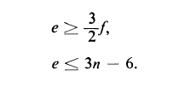
Corollary:
If G is connected simple planar graph with f regions, n(>=3) vertices and e edges, the following inequalities must hold:

Slide 53
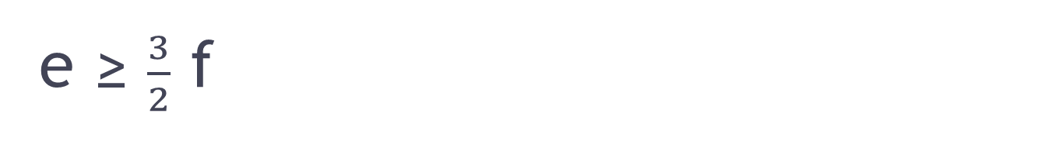
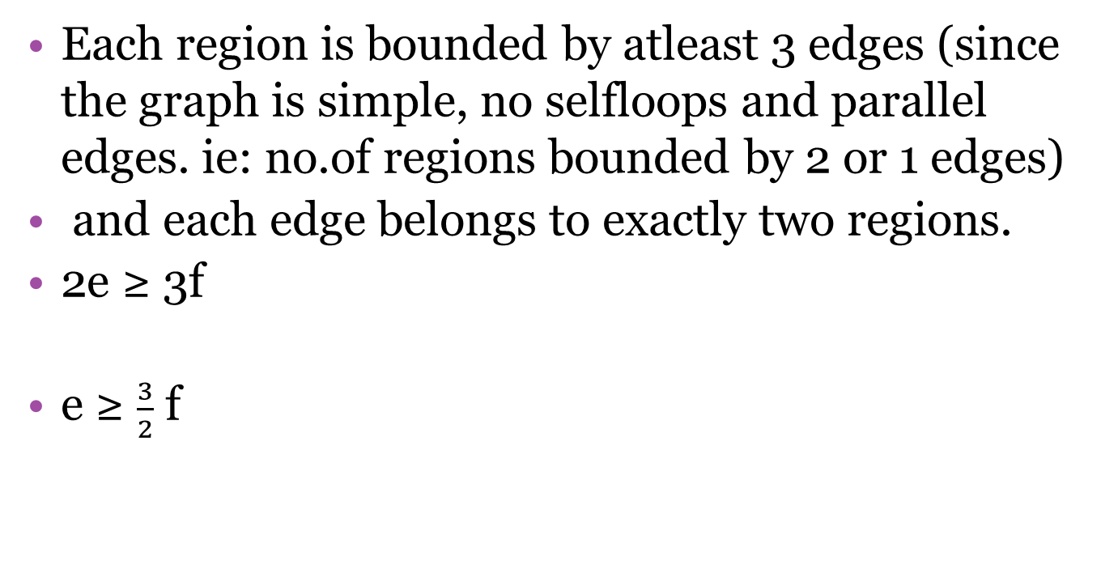

Slide 54
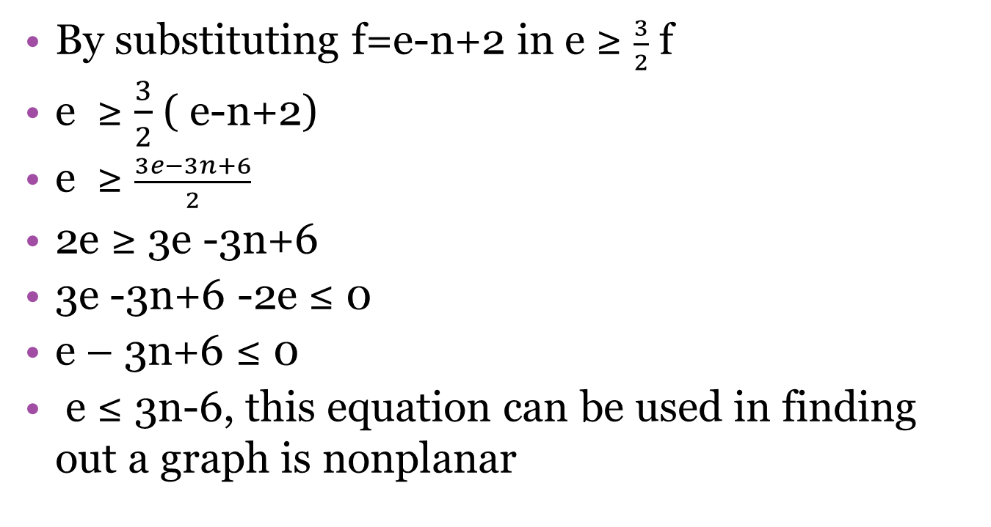
e ≤ 3n-6

Slide 55
Kuratowski’s Nonplanar proofs – 1st graph K5
In the case of K5, check for inequality e ≤ 3n-6
n = 5 and e= 10
RHS = 3n – 6 = 3 * 5 – 6 = 9
e ≤ 3n-6
10 ≤ 9, a contradiction
K5 violates inequality and hence it is not planar

Slide 56
Kuratowski’s Nonplanar proofs – 2nd graph K3,3
In K3,3 , n=6 and e = 9
RHS, 3n – 6 => 3* 6 – 6 => 12
e ≤ 3n-6,
9 ≤ 12 , satisfies inequality, yet the graph is non-planar.
So to prove the non-planarity of K3,3 we make use of the additional fact.

Slide 57
No region in this graph can be found with fewer than four edges. Thus if this graph were planar,
2e ≥ 4f
2e ≥ 4(e-n+2)
2 *9 ≥ 4( 9-6+2)
18 ≥ 20, a contradiction;
Violate the condition. Hence the graph cannot be planar.

Slide 58
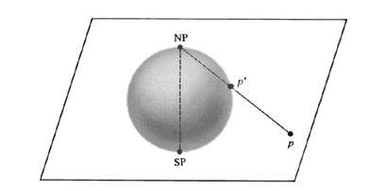
Embedding on a Sphere
It is accomplished by stereographic projection of a sphere on the plane.

Slide 59
Put the sphere on the plane and call the point of contact SP (south pole).
At point SP, draw a straight line perpendicular to the plane and let the point where line intersects the surface of the sphere be called NP (north pole)
Now corresponding to any point p on the plane, there exists a unique point p’ on the sphere, where p’ is the point at which the straight line from point p to point NP intersects the surface of the sphere.

Slide 60
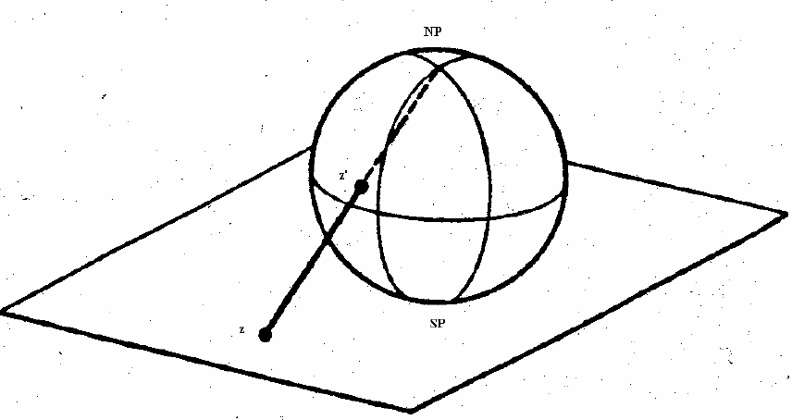

Slide 61
Thus there is a one-to-one correspondence between the points of the sphere and the finite points on the plane, and points at infinity in the plane correspond to the point NP on the sphere.
Theorem:
A graph can be embedded in the surface of a sphere if and only if it can be embedded in a plane .

Slide 62
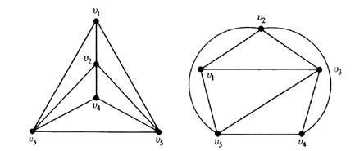
Unique Embedding
If of all possible embeddings on a sphere no two are distinct, the graph is said to have a unique embedding on a sphere.

Slide 63
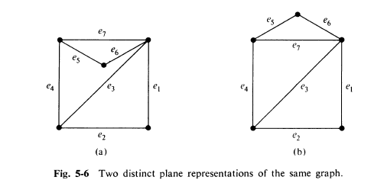

Slide 64
Detection of Planarity
We can check whether the given graph is planar or not, through the steps of Elementary Reduction.
Step 1:
A disconnected graph is planar if and only if each of its components is planar.
Also a separable graph is planar if and only if each of its blocks is planar.
Therefore, for the given arbitrary graph G, determine the set G={G1,G2,....Gk}, where each Gi is a non-separable block of G. Then we have to test each Gi, for planarity.

Slide 65
Step 2:
Since addition or removal of self loops does not affect planarity, remove all self loops.
Step 3:
Since parallel edges also do not affect planarity, eliminate edges in parallel by removing all but one edge between every pair of vertices.
Step 4:
Elimination of a vertex of degree two by merging two edges in series does not affect planarity. Therefore, eliminate all edges in series.
[In a graph two edges are said to be in series if they have exactly one vertex in common and if this vertex is of degree two].

Slide 66
Step 5:
Repeated application of steps 2, 3 and 4 will reduce the graph into a new graph which has any one of the following property:
Graph has a single edge.
A complete graph with 4 vertices.
A nonseparable, simple graph with n≥5 and e≥7.
If it is (i) or (ii), the graph is planar and need not be checked further.
But if it is (iii) we need to use Euler’s theorem and planarity inequality for planarity detection, continue to Step 6.

Slide 67
Step 6:
Check whether e<=3n-6 for the resultant graph.
If it is not satisfied, the graph is non-planar.
If it satisfies, we need to check further.
Step 7:
Check whether the resultant graph contains either of Kuratowski’s graphs or their Homeomorphs as its subgraph.
If it contains K5 or K3,3, then the graph is certainly non-planar.

Slide 68
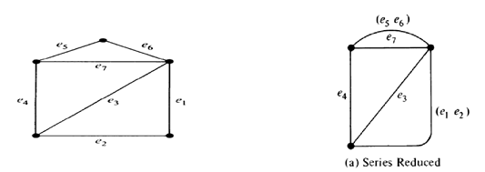
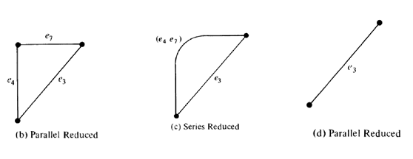

Slide 69
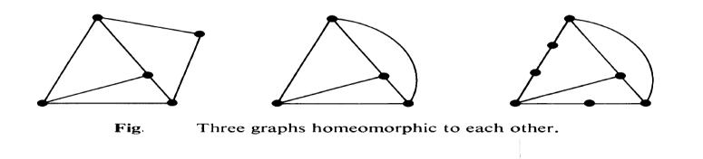
Homeomorphic Graphs
Two graphs are said to be homeomorphic if one graph can be obtained from the other by the creation of edges in series (i.e., by insertion of vertices of degree two) or by the merger of edges in series.

Slide 70
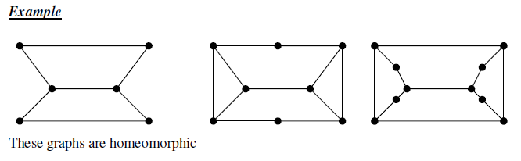

Slide 71
Kuratowski’s Theorem
A necessary and sufficient condition for a graph G to be planar is that G does not contain either of Kuratowski’s two graphs or any graph homeomorphic to either of them.

Slide 72
Geometric Dual
In order to obtain the geometric dual of a planar graph,
Start with a plane representation of the planar graph.
Name the regions or faces are F₁,F₂,F₃,....,F_{e-n+2.}
Place a point p_{i} in each face F_{i.}

Slide 73
If two regions F_{i} and F_{j} and are adjacent(i.e., have a common edge), draw a line joining points p_{i} and p_{j} that intersects the common edge between and exactly once.
If there is more than one edge common between F_{i} and F_{j} , draw one line between points p_{i} and p_{j} for each of the common edges.

Slide 75
For an edge e lying entirely in one region, say F_{k}, draw a self-loop at points intersecting e exactly once.
By this procedure we obtain a new graph G∗ (broken lines in the figure) consisting of six vertices p_{1,} p_{2,......,} p₆ and edges joining these vertices. Such a graph G∗ is called a dual or geometric dual of G.

Slide 76
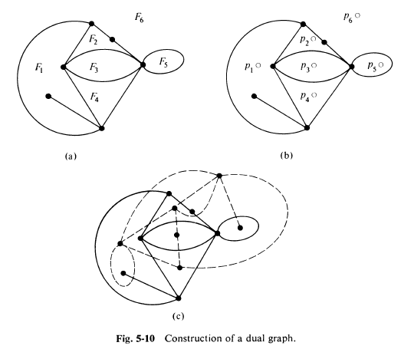

Slide 77
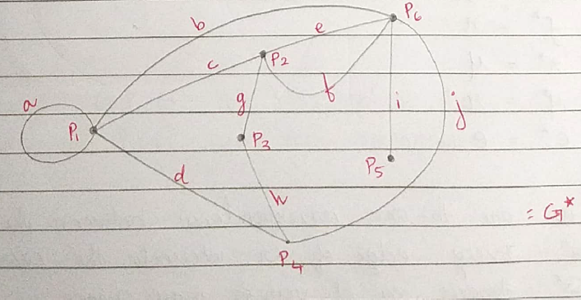

Slide 78
Relationship between a planar G and its dual G∗
An edge forming a self loop in G yields a pendant edge in G∗ .
A pendant edge in G yields a self loop in G∗.
Edges that are in series in G produce parallel edges in G∗.
Parallel edges in G produce edges in series in G∗.
Number of edges constituting the boundary of a region in G is equal to the degree of the corresponding vertex p_{i} in G∗ and vice-versa.

Slide 79
Relationship between a planar G and its dual G∗
Graph G∗ is also embedded in a plane, so it is planar.
G and G∗ are called dual graphs.
If n, e, f, r and µ denotes the number of vertices, edges, regions, rank and nullity of a connected planar graph G and if n∗, e∗, f∗, r∗ and µ∗ are the corresponding numbers in dual graph G∗, then

Slide 80
n∗ = f,
e∗= e,
f∗ = n.
r∗ = µ
µ∗ = r

Slide 81
Theorem
Two planar graphs G and G∗ are said to be duals of each other if there is a one-to-one correspondence between the edges in G and G∗ such that a set of edges in G forms a circuit if and only if the corresponding set in G∗ forms a cut set.

Slide 82
Dual of Sub Graph
Let G be a planar graph and G* be its dual.
Let a be an edge in G, and the corresponding edge in G* be a*.
Suppose that we delete an edge a from G and then try to find the dual of G –a.
If edge a was on the boundary of two regions, removal of a would merge these two regions into one.

Slide 83
Dual of Sub Graph
Thus the dual of (G−a)* can be obtained from G* by deleting the corresponding edge a* and then fusing the two end vertices of a* in G*- a*.
If the edge a is not the boundary, a* forms a self loop.
In that case G*- a* is the same as (G−a)*.
Thus if a graph G has a dual G*, the dual of any subgraph of G can be obtained by successive application of this procedure.

Slide 84
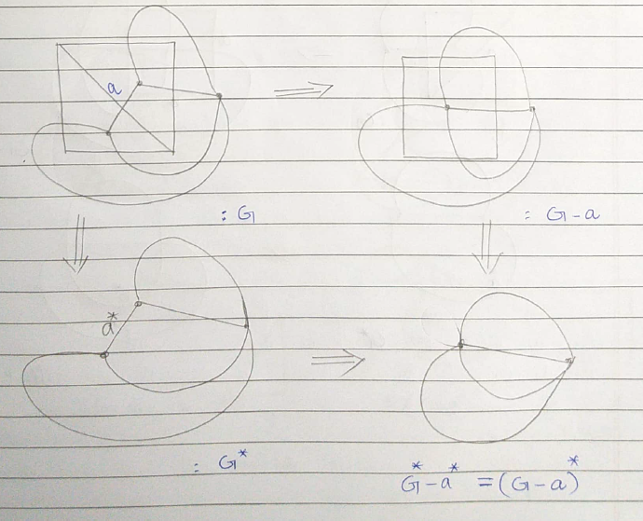

Slide 85
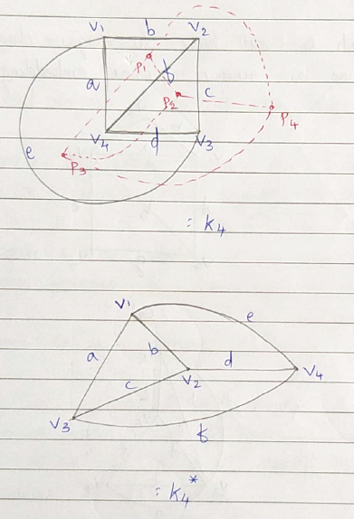
Self Dual Graphs
If a planar graph G is isomorphic to its own dual, it is called a self dual graphs.

Slide 86
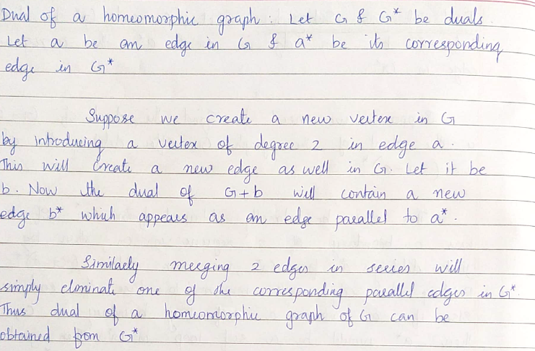
Dual of a Homeomorphic Graph

Slide 87
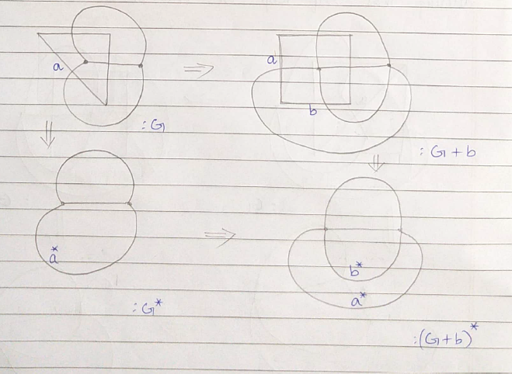
Dual of a Homeomorphic Graph

Slide 88
Theorem:
A graph has a dual if and only if it is planar.

Slide 89

Combinatorial Dual
Two planar graphs G and G∗ are said to be combinatorial duals of each other if there is one-to-one correspondence between the edges of G and G∗ such that if g is any subgraph of G and h is the corresponding subgraph of G∗ then
Rank of (G* - h) = rank of G* - nullity of g

Slide 90

An Example
Consider the graph G
and its dual G*.
Take the subgraph
g= {e₄, e₅, e₆, e₇} in G
and its corr. subgraph
h = {e₄*, e₅*, e₆*, e₇*} in G*.

Slide 91
Rank of(G*- h)=rank of G*-nullity of g
LHS,
rank of (G*- {e₄*, e₅*, e₆*, e₇*} ) =
rank of {e₁*, e₂*, e₃*} = 2
Rank of G* = 3
Nullity of {e₄, e₅, e₆, e₇} = 1
RHS=> 3-1 = 2
LHS = RHS

Slide 92
Thickness
Least number of planar subgraphs whose union is the given graph G is the thickness of G.
Thickness of planar graph is one.
Thickness of Kuratowski’s graph is two.
Thickness of a complete graph with 8 vertices is two.
Thickness of a complete graph with 9 vertices is three.

Slide 93
Crossings
Least number of crossing or intersections necessary in order to draw the graph in the plane.
Crossing number of planar graph is zero.
Crossing number of Kuratowski’s graph is one.

Slide 94
Thank you

